Slide 1
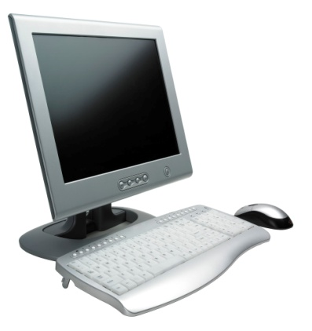
Host and Data Security
Chapter 7

Slide 2
Orientation
By the end of this chapter, the student should be able to discuss the following:
➢ The elements of host hardening, security baselines and images, and systems administrators
➢ Important server operating systems
➢ Vulnerabilities and patches
➢ Managing users and groups
➢ Managing permissions
➢ Testing for vulnerabilities
➢ Windows client PC security, including centralized PC security management
➢ Data protection: backup
➢ Other data protections: encryption, data destructions, and document restrictions

Slide 3
7-1: Threats to Hosts
The Problem
Some attacks inevitably reach host computers
So servers and other hosts must be hardened— a complex process that requires a diverse set of protections to be implemented on each host

Slide 4
7-1: Threats to Hosts
What Is a Host?
Anything with an IP address is a host (because it can be attacked)
Servers
Clients (including mobile telephones)
Routers (including home access routers) and sometimes switches
Firewalls

Slide 5
7-2: Elements of Host Hardening
Backup
Backup
Backup
Restrict physical access to hosts (see Chapter 5)
Install the operating system with secure configuration options
Change all default passwords, etc.

Slide 6
7-2: Elements of Host Hardening
Minimize the applications that run on the host
Harden all remaining applications on the host (see Chapter 8)
Download and install patches for operating vulnerabilities
Manage users and groups securely
Manage access permissions for users and groups securely

Slide 7
7-2: Elements of Host Hardening
Encrypt data if appropriate
Add a host firewall
Read operating system log files regularly for suspicious activity
Run vulnerability tests frequently

Slide 8
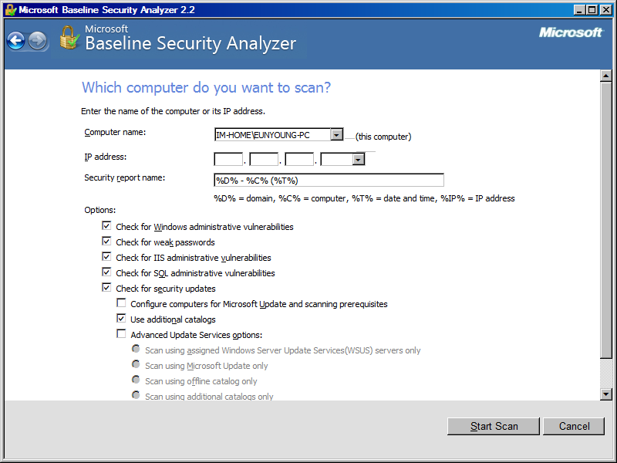
MS Baseline Security Analyzer

Slide 9

7-3: Security Baselines and Systems Administrators
Security Baselines Guide the Hardening Effort
Specifications for how hardening should be done
Needed because it is easy to forget a step
Different baselines for different operating systems and versions
Different baselines for servers with different functions (webservers, mail servers, etc.)
Used by systems administrators (server administrators)
Usually do not manage the network

Slide 10
7-3: Security Baselines and Systems Administrators
Security Baselines Guide the Hardening Effort
Disk Images
Can also create a well-tested secure implementation for each operating system versions and server function
Save as a disk image
Load the new disk image on new servers

Slide 11
7-4: Windows Server Operating Systems
Windows Server
The Microsoft Windows Server operating system
Windows NT, 2003, and 2008
Windows Server Security
Intelligently minimize the number of running programs and utilities by asking questions during installation
Simple (and usually automatic) to get updates
Still many patches to apply, but this is true of other operating systems

Slide 12
MS Windows Operating Systems
Windows XP
Windows Vista
Windows 7
Windows Server 2003
Windows Server 2008

Slide 13
Windows XP
Home and Professional edition
Features unique in XP Professional
Support Active Directory domains
IPsec and PKI support
Domain-based Group Policy Objects (GPOs)
Encrypting File System (EFS)
Etc
XP Service Pack 2
XP Service Pack 3

Slide 14
Windows Vista & Windows 7
Security Enhancements
BitLocker for whole disk encryption
User Access Control
IE 7.0/8.0
Windows 7 is almost Windows Vista R2

Slide 15
Windows Servers
Windows Server 2003
Active Directory
IIS
Exchange Server
SQL Server
File and Print Server
Network Services (DNS, DHCP, and RADIUS)
Windows Server 2008

Slide 16
7-5: Windows 2008 Server User Interface
Looks like client
versions of Windows
Ease of learning and use
Choose Administrative Tools
for most programs
Tools are called
Microsoft Management
Consoles (MMCs)
Copyright Pearson Prentice-Hall 2009

Slide 17
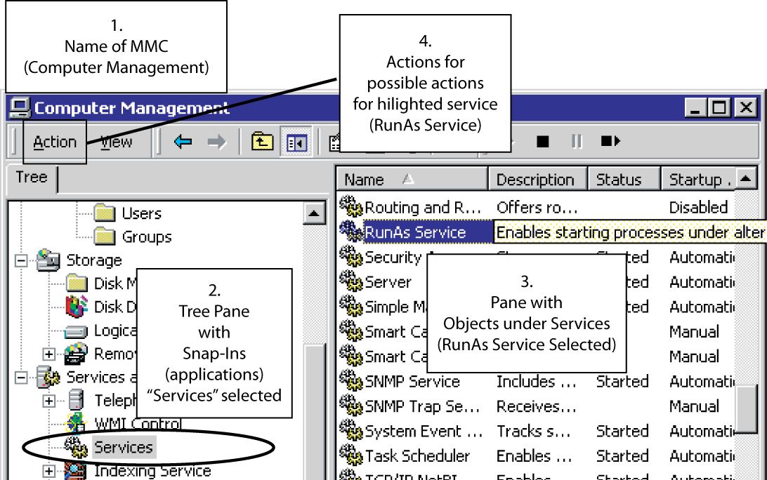
7-6: Computer Management Microsoft Management Console (MMC)
MMCs have standard
user interfaces

Slide 18
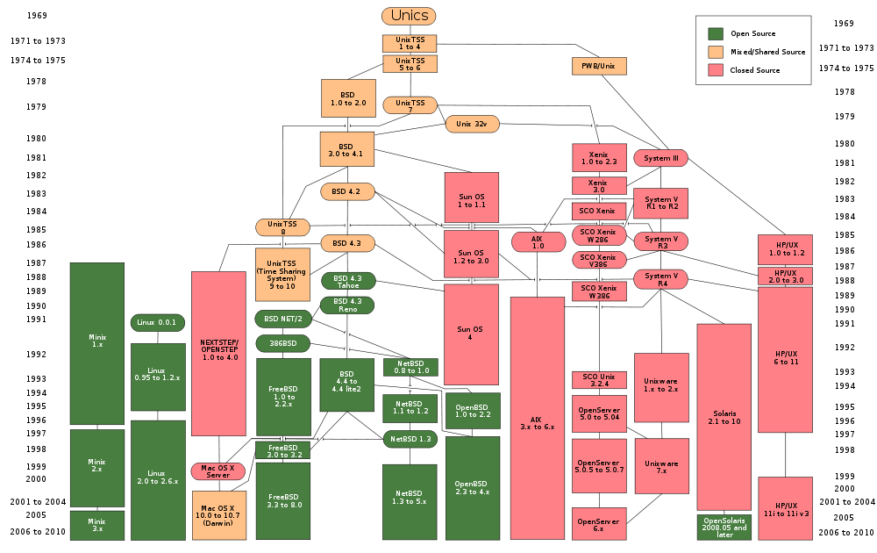
UNIX History
* Source: Wikipedia

Slide 19
7-7: UNIX Operating Systems
Many Versions of UNIX
There are many commercial versions of UNIX for large servers
Compatible in the kernel (core part) of the operating system
Can generally run the same applications
But may run many different management utilities, making cross-learning difficult

Slide 20

7-7: UNIX Operating Systems
LINUX is a version of UNIX created for PCs
Many different LINUX distributions
Distributions include the LINUX kernel plus application and programs, usually from the GNU project
Each distribution and version needs a different baseline to guide hardening
Free or inexpensive to buy
But may take more labor to administer
Has moved beyond PC, to use on servers and some desktops

Slide 21
Variants of UNIX
Cygwin for Windows
Linux distributions
Ubuntu (Debian-based )
Mint (Ubuntu-based)
Fedora (by RedHat)
Mac OS (BSD)
Password Assistant
FileVault
OpenSSH
IPFW firewall

Slide 22

7-7: UNIX Operating Systems
User Can Select the User Interface
Multiple user interfaces are available (unlike Windows)
Graphical user interfaces (GUIs)
Command line interfaces (CLIs)
At prompts, users type commands
Unix CLIs are called shells (Bourne, BASH, etc.)
>ls -1
…

Slide 23
7-8: Vulnerabilities and Exploits
Vulnerabilities
Security weaknesses that open a program to attack
An exploit takes advantage of a vulnerability
Vendors develop fixes
Zero-day exploits: exploits that occur before fixes are released
Exploits often follow the vendor release of fixes within days or even hours
Companies must apply fixes quickly

Slide 24
7-8: Vulnerabilities and Exploits
Fixes
Work-arounds
Manual actions to be taken
Labor-intensive so expensive and error-prone
Patches:
Small programs that fix vulnerabilities
Usually easy to download and install
Service packs (groups of fixes in Windows)
Version upgrades
Often, security vulnerabilities are fixed in new versions
If a version is too old, the vendor may even stop offering fixes

Slide 25
7-9: Applying Patching
Problems with Patching
Must find operating system patches
Windows Server does this automatically
LINUX versions often use RPM (RPM Package Manager )
Companies get overwhelmed by number of patches
Use many programs; vendors release many patches per product
Especially a problem for a firm’s many application programs

Slide 26
7-9: Applying Patching
Problems with Patching
Cost of patch installation
Each patch takes some time and labor costs
Usually lack the resources to apply all
Prioritization
Prioritize patches by criticality
May not apply all patches, if risk analysis does not justify them

Slide 27

7-9: Applying Patching
Problems with Patching
Risks of patch installation
Reduced functionality
Freeze machines, do other damage—sometimes with no uninstall possible
Should test on a test system before deployment on servers

Slide 28
Patch Management Solutions
Windows Server Update Services (WSUS)
2011 Windows IT Pro’s Choice:
VMware vCenter Protect Essentials Plus (VMWare)
Desktop Central 7 (Zoho)
GFI LanGuard 2011 (GFI Software)
Altiris Client Management Suite (Symantec)

Slide 29


7-10: Managing Users and Groups
XYZ
Accounts
Every user must have an account
Groups
Individual accounts can be consolidated into groups
Can assign security measures to groups
Inherited by each group’s individual members
Reduces cost compared to assigning to individuals
Reduces errors
XYZ

Slide 30
7-11: Users and Groups in Windows
2.
Select a
particular user
1.
Select Users
or Groups
Right-click.
Select properties.
Change selected properties.

Slide 31
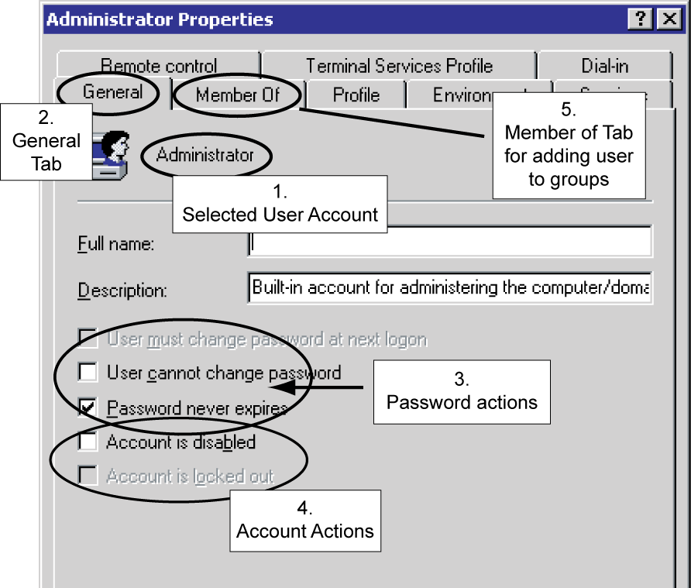
7-13: Windows User Account Properties
Administrator
Account
selected

Slide 32
7-12: The Super User Account
Super User Account
Every operating system has a super user account
The owner of this account can do anything
Called Administrator in Windows
Called root in UNIX
Hacking Root
Goal is to take over the super user account
Will then “own the box”
Generically called hacking root

Slide 33
7-12: The Super User Account
Appropriate Use of a Super User Account
Log in as an ordinary user
Switch to super user only when needed
In Windows, the command is RunAs
In UNIX, the command is su (switch user)
Quickly revert to ordinary account when super user privileges are no longer needed

Slide 34
7-14: Managing Permissions in Windows
Permissions
Specify what the user or group can do to files, directories, and subdirectories
Assigning Permissions in Windows (Fig. 7-15)
Right click on file or directory
Select Properties, then Security tab
Select a user or group
Select the 6 standard permissions (permit or deny)
For more fine-grained control, 13 special permissions

Slide 35
7-15: Assigning Permissions in Windows

Slide 36
7-16: The Inheritance of Permission
Inheritance
If the Allow inheritable permissions from parent to propagate to this object box is checked in the security tab, the directory receives the permissions of the parent directory.
This box is checked by default, so inheritance from the parent is the default

Slide 37

7-16: The Inheritance of Permission
XYZ
Inheritance
Total permissions include
Inherited permissions (if any)
Plus the Allow permissions checked in the Security tab
Minus the Deny permissions checked in the Security tab
The result is the permissions level for a directory or file
XYZ

Slide 38
7-16: The Inheritance of Permission
Directory Organization
Proper directory organization can make inheritance a great tool for avoiding labor
Example: Suppose the all logged-in user group is given read and execute permissions in the public programs directory
Then all programs in this directory and its subdirectories will have read and execute permissions for everyone who is logged in
There is no need to assign permissions to subdirectories and their files

Slide 39
7-17: Assigning Permissions in Windows and UNIX
Category | Windows | UNIX
Number of permissions | 6 standard, 13 specialized if needed | Only 3: read (read only), write (make changes), and execute (for programs). Referred to as rwx
For a file or directory, different permissions can be assigned to | Any number of individual accounts and groups | The account owner A single group, and All other accounts

Slide 40
7-18: Vulnerability Testing
Mistakes Will Be Made in Hardening
So do vulnerability testing
Run Vulnerability Testing Software on Another Computer
Run the software against the hosts to be tested
Interpret the reports about problems found on the server
This requires extensive security expertise
Fix them

Slide 41
7-18: Vulnerability Testing
Get Permission for Vulnerability Testing
Looks like an attack
Must get prior written agreement
Vulnerability testing plan
An exact list of testing activities
Approval in writing to cover the tester
Supervisor must agree, in writing, to hold the tester blameless if there is damage
Tester must not diverge from the plan

Slide 42
7-19: Windows Client PC Security
Client PC Security Baselines
For each version of each operating system
Within an operating system, for different types of computers (desktop versus notebook, on-site versus external, high-risk versus normal risk, and so forth)
Automatic Updates for Security Patches
Completely automatic updating is the only reasonable policy

Slide 43

7-19: Windows Client PC Security
Antivirus and Antispyware Protection
Important to know the status of antivirus protection
Users turn off or turn off automatic updating for virus signatures
Users do not pay the annual subscription and so get no more updates
Windows Firewall
Stateful inspection firewall
Accessed through the Security Center (or Action Center)

Slide 44
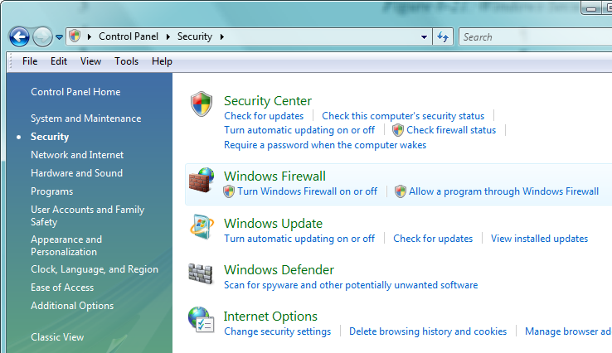
Figure 7-20: Windows Security Center
Security Center
Check for updates
Check this computer’s security status
Turn automatic updating on or off
Check firewall status
Require a password when the computer wakes

Slide 45
Figure 7-20: Windows Security Center
Windows Firewall
Turn Windows Firewall on or off
Allow a program through Windows Firewall
Windows Update
Turn automatic updating on or off
Check for updates
View installed updates

Slide 46
Figure 7-20: Windows Security Center
Internet Options
Change security centers
Delete browsing history and cookies
Manage browser add-ins
Windows Defender
Spyware scanner

Slide 47
7-21: Protecting Notebook Computers
Threats
Loss or theft
Loss of capital investment
Loss of data that was not backed up
Loss of trade secrets
Loss of private information, leading to lawsuits

Slide 48
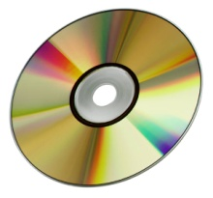
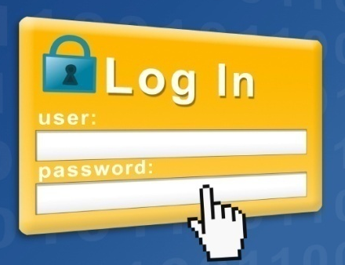
7-21: Protecting Notebook Computers
Backup
Before taking the notebook out
Frequently during use outside the firm
Use a Strong Password
If attackers bypass the operating system password, they get open access to encrypted data
The loss of login passwords is a major concern

Slide 49
7-21: Protecting Notebook Computers
Policies for Sensitive Data
Four main policies:
Limit what sensitive data can be stored on all mobile devices
Require data encryption for all data
Protect the notebook with a strong login password
Audit for the previous two policies
Apply policies to all mobile data on disk drives, USB RAM drives, MP3 players that store data, and even mobile phones that can store data

Slide 50
7-21: Protecting Notebook Computers
Other Measures
Teach users loss and theft protection techniques
Use notebook recovery software
Contacts the recovery company the next time the computer connects to the Internet
The recover company contacts local police to recover the software

Slide 51
7-22: Centralized PC Security Management
Importance
Ordinary users lack the knowledge to manage security on their PCs
They sometimes knowingly violate security policies
Also, centralized management often can reduce costs through automation

Slide 52
7-22: Centralized PC Security Management
Standard Configurations for PCs
May restrict applications, configuration settings, and even the user interface
Ensure that the software is configured safely
Enforce policies
More generally, reduce maintenance costs by making it easier to diagnose errors

Slide 53



7-22: Centralized PC Security Management
Network Access Control (NAC)
Goal is to reduce the danger created by computers with malware
Control their access to the network
Network

Slide 54
7-22: Centralized PC Security Management
Network Access Control (NAC)
Stage 1: Initial Health Check
Checks the “health” of the computer before allowing it into the network
Choices:
Admit to the network
Reject: do not admit
Quarantine and pass it to a remediation server; retest after remediation

Slide 55
7-22: Centralized PC Security Management
Network Access Control (NAC)
Stage 2: Ongoing Traffic Monitoring
If traffic after admission indicates malware on the client, drop or remediate
Not all NAC systems do this

Slide 56
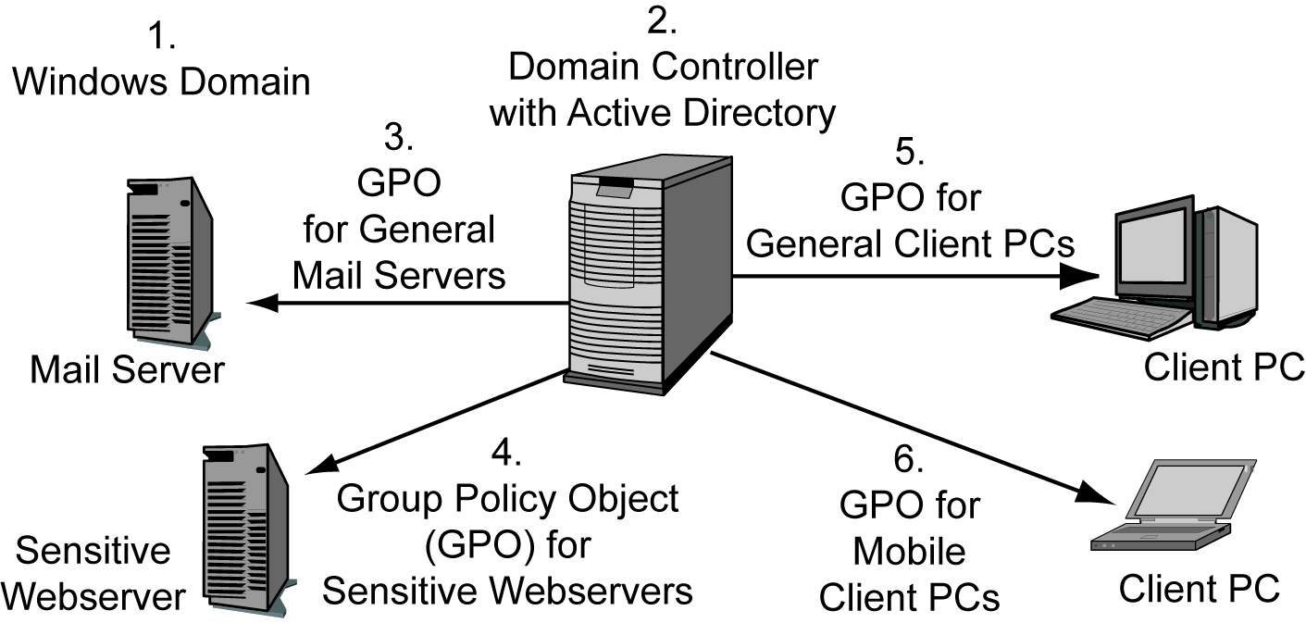
7-23: Windows Group Policy Objects (GPOs)

Slide 57
7-24: Data Protection: Backup
Importance
In an incident, you may lose all data that is not backed up
Threats that Are Addressed by Backup
Mechanical hard drive failure or damage in a fire or flood
Data on lost or stolen computers is not available to the organization
Malware can reformat the hard drive or do other data destruction

Slide 58
7-25: Scope of Backup
Scope of Backup
Fraction of information on the hard drive that is backed up
File/Directory Data Backup
Select data files and directories to be backed up
(Do not forget items on the desktop!)
Not good for programs

Slide 59
7-25: Scope of Backup
Image Backup
Everything, including programs and settings
Image backup is very slow
Data files change the most rapidly, so doing several file/directory data backups for each image backup may be appropriate
Shadowing
Whenever the user saves a file, the backup software saves a copy to a USB flash drive or another storage location

Slide 60
7-26: Full versus Incremental Backup
Full backups
All files and directories
Slow, so it is typically done weekly
Incremental Backups
Only records changes since the last backup
Fast, so usually done daily
Do incremental backups until the next full backup

Slide 61
7-26: Full versus Incremental Backup
Restoration Order
Restore the full backup first
Then restore incremental backups in the order created
(Otherwise, newer files will be overwritten)
Generations
Save several generations of full backups
Usually do not save incremental backups after the next full backup

Slide 62
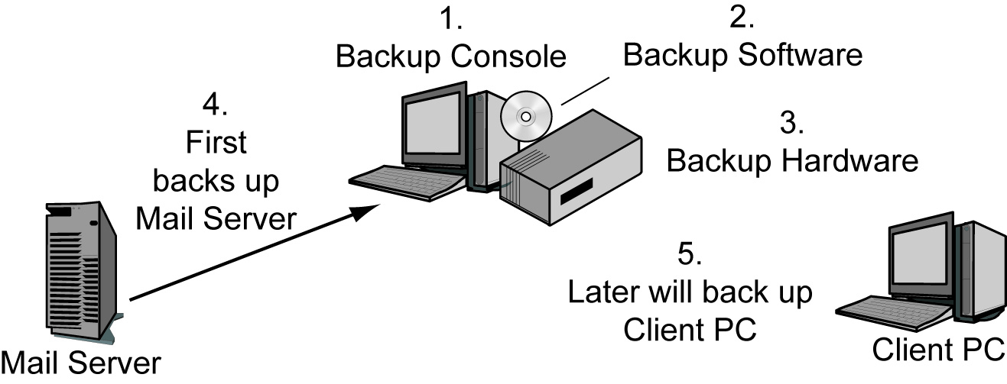
7-28: Centralized Backup
Local backup on individual PCs difficult to enforce
Centralized backup provides backup labor and enforcement

Slide 63
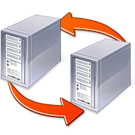
7-27: Backup Technologies
Continuous Data Protection (CDP)
Used when a firm has two server locations
Each location backs up the other in real time
Other site can take over very quickly in case of a disaster, with little data loss
Requires expensive high–speed transmission link between the sites

Slide 64
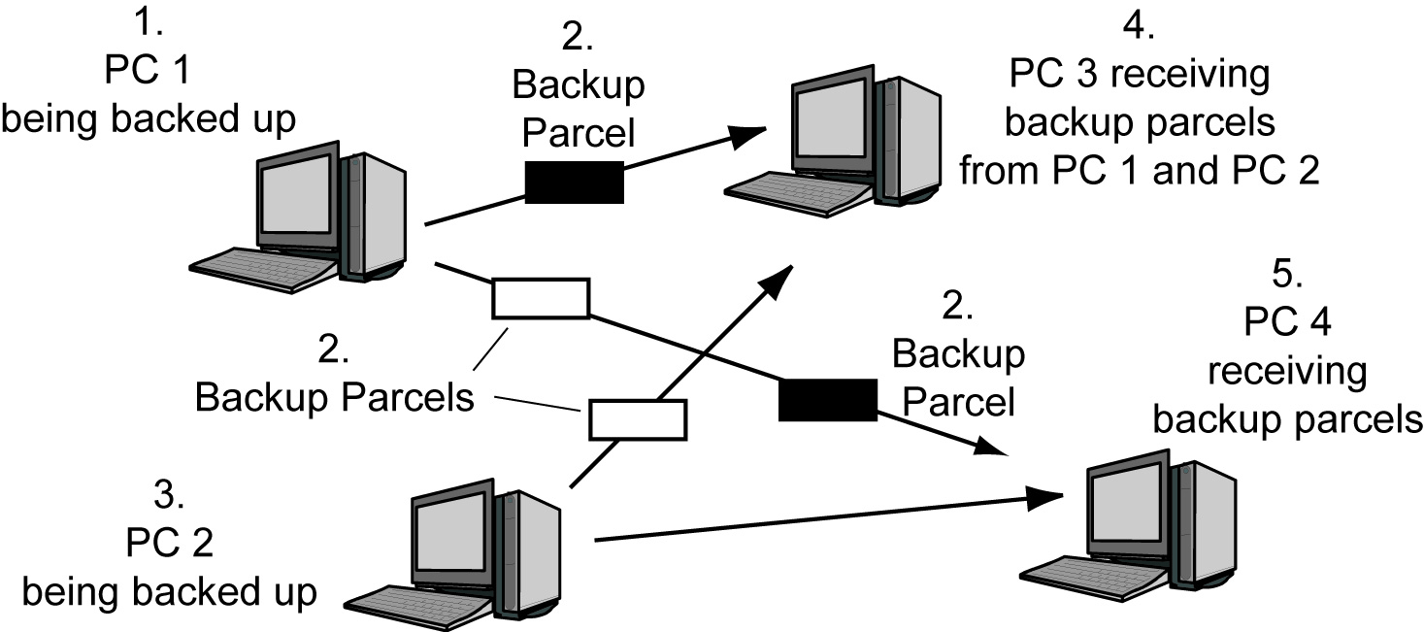
7-29: Mesh Backup
PCs back up one another.
Data is stored redundantly.
Security issues must be faced.

Slide 65
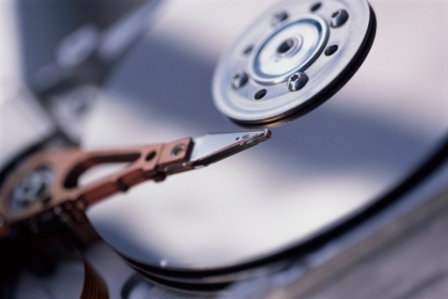
7-30: Backup Media
Servers Normally Use Magnetic Tape
Slow but inexpensive per bit stored
Second hard drive on computer
Very fast backup
But lost if computer is stolen or burns in a fire
Backup up on tape occasionally for archival (long-term storage)

Slide 66
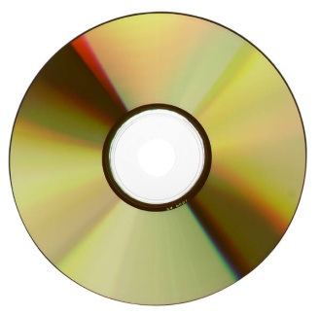
7-30: Backup Media
Clients Normally Use Optical disks (DVDs)
Attraction is that almost all users have optical disk burners
Dual-layer DVDs offer about 8 GB of capacity
This often is not enough
User may have to insert additional disks to do backup
Backup up to a second client PC hard drive; then occasionally back up onto optical disks
The life of information on optical disks is unknown

Slide 67

7-31: Backup Management Policies
Backup Creation Policies
Understand current system and future needs
Create policies for different types of data and computer
What should be backed up, how frequently, how frequently to test restorations, etc.
Restoration Policies
Do restoration tests frequently

Slide 68
7-31: Backup Management Policies
Media Storage Location Policies
Store media at a different site
Store backup media in a fireproof and waterproof safe until it can be moved offsite
Encryption Policies
Encrypt backup media before moving them so that confidential information will not be exposed if the tape is stolen or lost

Slide 69
7-31: Backup Management Policies
Strongly Access Control Policies for Backup Media
Checkouts are rare and therefore suspicious
Checking out media can result in their loss and the damages that come with this loss
The manager of the person requesting the checkout should approve the checkout

Slide 70
7-31: Backup Management Policies
Data Retention Policies
There are strong legal requirements for how long certain types of data must be kept
The legal department must get involved in retention policies.
Auditing Policy Compliance
All policies should be audited
Includes tracing what happened in samples of data

Slide 71
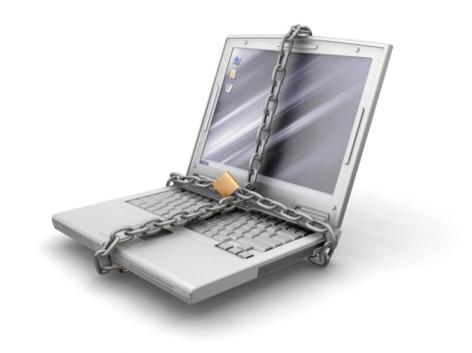
7-32: Data Protection: Encryption
Encryption
Makes data unreadable to someone who does not have the key
Prevents theft of private or trade secret information
May reduce legal liability if lost or stolen data is encrypted
What to Encrypt
Files and directories
The entire disk

Slide 72
7-32: Data Protection: Encryption
Key Escrow
Loss of the key is disastrous
Not like losing a password that can be reset
Key escrow stores a copy of the key in a safe place
Bad if managed by user
May not do it
May not be able to find it
If fired, may refuse to give it, locking up all data on the computer
Central key escrow on a corporate server is better

Slide 73
7-32: Data Protection: Encryption
Strong Login Authentication Is Needed
Encryption is transparent to logged in users
Once a user is logged in, he or she can see all encrypted data
Protect with strong password or biometrics
Ensure that the password is not lost
File-Sharing Problems
File sharing may be more difficult because files usually have to be decrypted before sending them to another computer

Slide 74
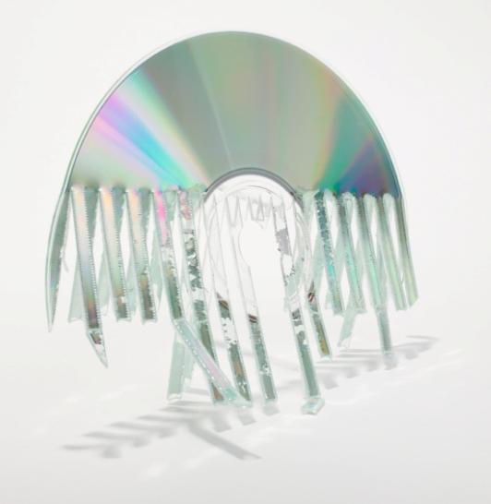
7-33: Data Destruction
Data Destruction Is Necessary
Backup media are not needed beyond their retention dates
If a computer is to be discarded
If the computer is to be sold or given to another user
Drive-wiping software for hard drives
Reformatting the hard drive is not enough
Shredding for CDs and DVDs

Slide 75
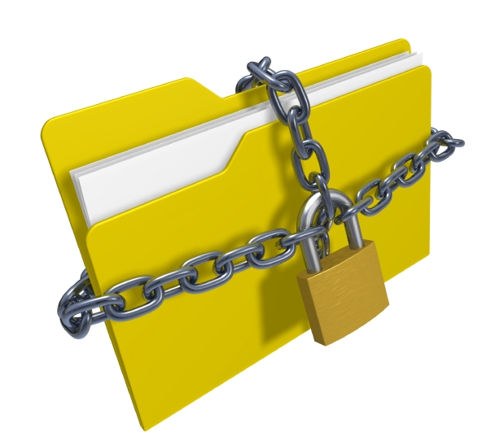
7-34: Document Restrictions
Document Restrictions
Attempt to restrict what users can do to documents, in order to reduce security threats
Embryonic
Digital Rights Management (DRM)
Prevent unauthorized copying, printing, etc.
May not be able to see parts of documents

Slide 76



7-34: Document Restrictions
Data Extrusion Management
Attempts to prevent restricted data files from leaving the firm without permission
Watermark with invisible restriction indicators
Can be notified if sent via e-mail attachments or FTP
If each document is given a different watermark, can forensically the source of a document leak
Traffic analysis to look for unusually large numbers of outgoing files sent by a user

Slide 77
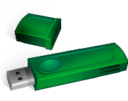

7-34: Document Restrictions
Removable Media Controls
Forbid the attachment of USB RAM drives and other portable media
Reduces user abilities to make copies
Perspective
Have proven difficult to enforce
Often reduces functionality in uncomfortable ways
Companies have been reluctant to use them

Slide 78
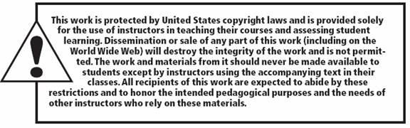
All rights reserved. No part of this publication may be reproduced, stored in a retrieval system, or transmitted, in any form or by any means, electronic, mechanical, photocopying, recording, or otherwise, without the prior written permission of the publisher. Printed in the United States of America.
Copyright © 2010 Pearson Education, Inc.
Publishing as Prentice Hall

